Slide 1
Cross-site scripting
Computer Security vulnerability typically found in web applications.

Slide 2

Refers to client-side code injection attack where in an attacker can execute malicious scripts into a website/web application
The most rampant of web application vulnerabilities
Attacker does not target a victim directly

Slide 3
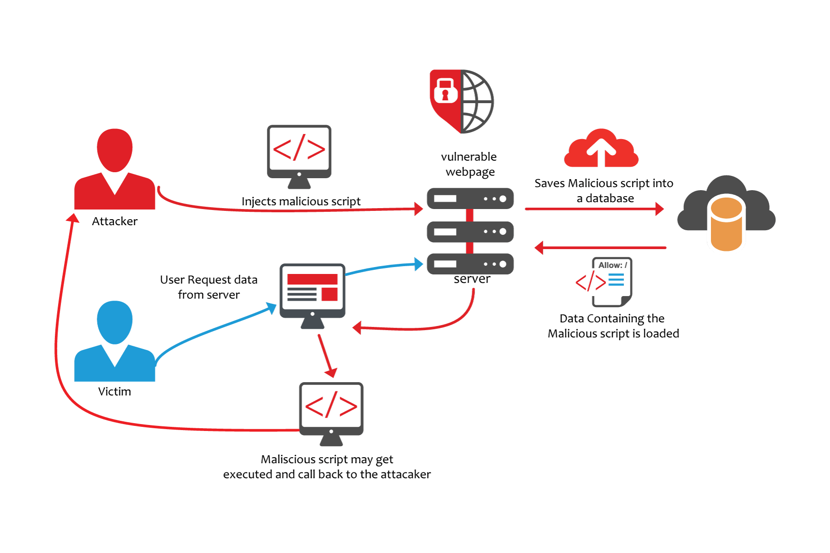
How it works?

Slide 4
Types of CSS
Stored XSS - occurs when user input is stored on the target server
Reflected XSS - occurs when user input is immediately returned by a web application in an error message
DOM Based XSS - entire tainted data flow from source to sink takes place in the browser, the source of the data is in the DOM, the sink is also in the DOM, and the data flow never leaves the browser.

Slide 5
RULE #0
Never Insert Untrusted Data Except in Allowed Locations
____________________________________________________
<script>...NEVER PUT UNTRUSTED DATA HERE...</script> directly in a script <!--...NEVER PUT UNTRUSTED DATA HERE...--> inside an HTML comment <div ...NEVER PUT UNTRUSTED DATA HERE...=test /> in an attribute name <NEVER PUT UNTRUSTED DATA HERE... href="/test" /> in a tag name <style>...NEVER PUT UNTRUSTED DATA HERE...</style> directly in CSS

Slide 6
RULE #1
HTML Escape Before Inserting Untrusted Data into HTML Element Content
____________________________________________________
<body>...ESCAPE UNTRUSTED DATA BEFORE PUTTING HERE...</body> <div>...ESCAPE UNTRUSTED DATA BEFORE PUTTING HERE...</div>

Slide 7
RULE #2
Attribute Escape Before Inserting Untrusted Data into HTML Common Attributes
____________________________________________________
inside UNquoted attribute
<div attr=...ESCAPE UNTRUSTED DATA BEFORE PUTTING HERE...>content</div>
inside single quoted attribute <div attr='...ESCAPE UNTRUSTED DATA BEFORE PUTTING HERE...'>content</div>
inside double quoted attribute <div attr="...ESCAPE UNTRUSTED DATA BEFORE PUTTING HERE...">content</div>

Slide 8
RULE #3
JavaScript Escape Before Inserting Untrusted Data into JavaScript Data Values
____________________________________________________
inside a quoted string
<script>alert('...ESCAPE UNTRUSTED DATA BEFORE PUTTING HERE...')</script>
one side of a quoted expression <script>x='...ESCAPE UNTRUSTED DATA BEFORE PUTTING HERE...'</script>
inside quoted event handler <div onmouseover="x='...ESCAPE UNTRUSTED DATA BEFORE PUTTING HERE...'"</div>

Slide 9
RULE #4
CSS Escape And Strictly Validate Before Inserting Untrusted Data into HTML Style Property Values
____________________________________________________
property value
<style>selector { property : ...ESCAPE UNTRUSTED DATA BEFORE PUTTING HERE...; } </style>
property value <style>selector { property : "...ESCAPE UNTRUSTED DATA BEFORE PUTTING HERE..."; } </style>
property value <span style="property : ...ESCAPE UNTRUSTED DATA BEFORE PUTTING HERE...">text</span>

Slide 10
RULE #5
URL Escape Before Inserting Untrusted Data into HTML URL Parameter Values
____________________________________________________
<a href="http://www.somesite.com?test=...ESCAPE UNTRUSTED DATA BEFORE PUTTING HERE...">link</a >

